Slide 1

Human Migration
By, Sobiya Khan

Slide 2

Human migration has been in existence since the earliest times. People move for various reasons, some might move due to work, economic opportunities, study while others might move to escape terrorism, persecution, climate change, natural disaster or human right violation.

Slide 3
Motivation
Having personally experienced the challenges of relocating for a better life, I felt inspired to explore migration patterns, not just to see where most migrants are coming from and where they’re headed, but also to understand why people make the difficult decision to leave their homeland. Is it often for the same reasons my family did, or are there other motivations that drive such a major life change? To gain insight, I focused on the top 10 countries of origin and destination, as well as the bottom 10, to capture a broad view of global migration trends.

Slide 4
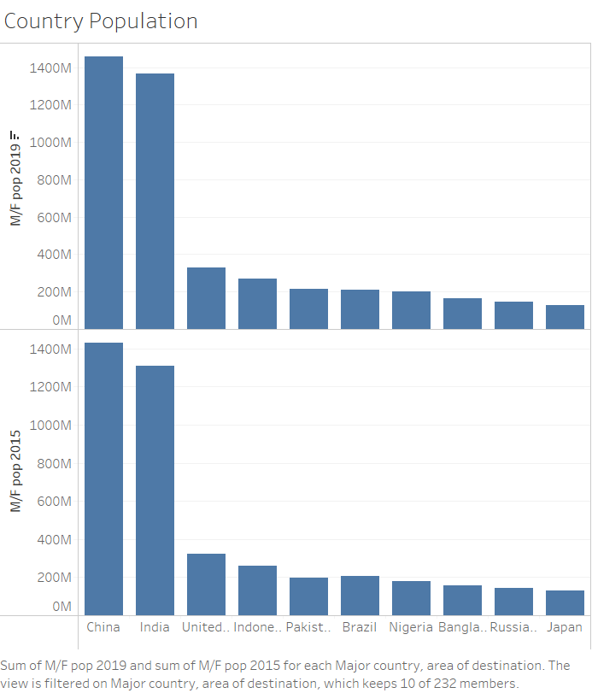

Slide 5
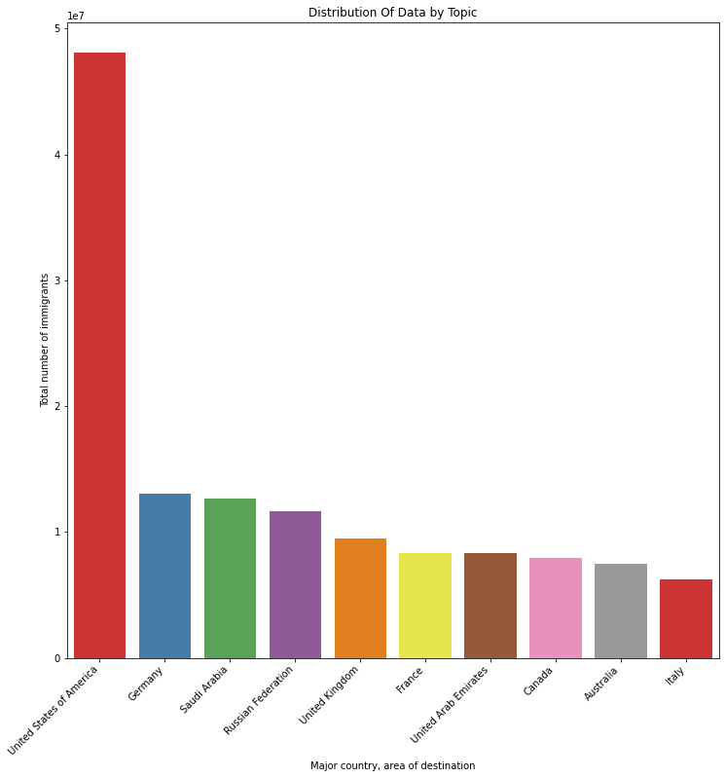
Key facts and figures from the World Migration Reports 2000 and 2020
Top 10 Countries by Destination 2015 / 2019
Estimated number of international migrants
Year 2000 : 150 million
Year 2020 : 272 million
Estimated proportion of world population who are migrants
Year 2000 : 2.8%
Year 2020 : 3.5%

Slide 6
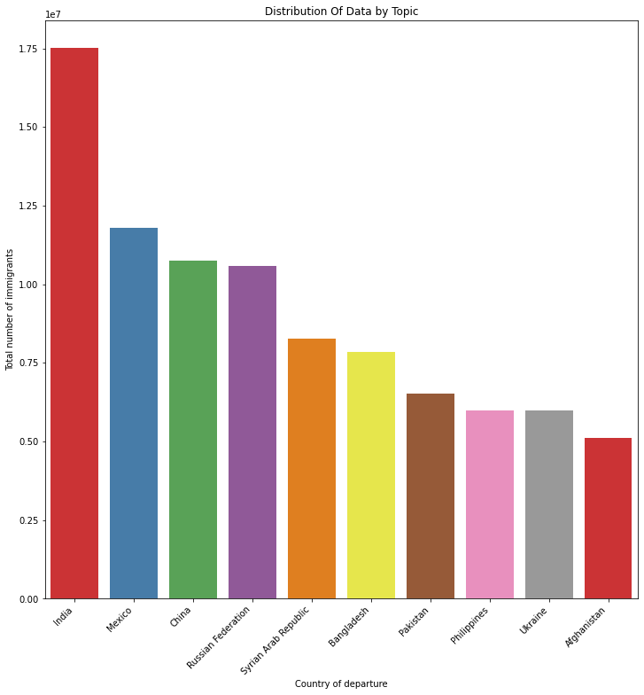
Top 10 Countries of Departure

Slide 7
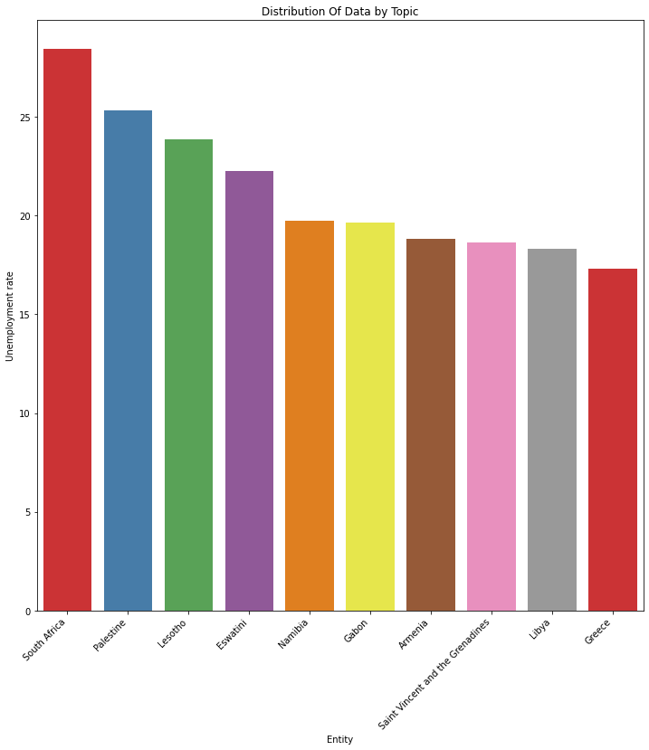
Top 10 Countries With Highest Unemployment Rate

Slide 8
Source of dataset
My dataset come from various non profit and government websites….
The dataset presents estimates of international migrants for all countries. The estimates are based on total international migrant stock by destination and origin.
source: United Nations- Department of Economics and Social Affairs

Slide 9
What are some other factors that result in Human migration?
I wanted to look into various other factors that might contribute towards migration, so I decided to pull some data on mass killing across all countries.
The data shows ranking of all countries by estimated risk of mass killing in 2021-22. The countries are ranked in descending order so the top 30 are considered to be at high risk.
The high-risk countries are categorized by factors such as ongoing mass killing, population size, infant mortality rate, Annual % change in GDP per capita, battled deaths, religious freedom.
Source: Early Warning Project – ushmm.org

Slide 10
Key Terms and their meaning
International Migrant Stock- number of people born in a country other than in which they live in.
SRA- Statistical Risk Assessment for Mass Killing
Infant Mortality Rate- the number of deaths of children under one year, expressed /1000 live births.
Religious Freedom- Freedom of religion: Is there freedom of religion?
0: Not respected by public authorities.
1: Weakly respected by public authorities
2: Somewhat respected by public authorities
3: Mostly respected by public authorities
4: Fully respected by public authorities
Battledeaths- Battle-related deaths
gdppcgrowth.combined- Annual % change in GDP per capita.
anymk.ongoing- Any ongoing mass killing
anymk.ever - Any mass killing ever

